Slide 1

The Art of Simplification: The Role of Animations in Physics Education
STEM Symposium
Tim de Wild — t.w.j.de.wild@rug.nl — 20-02-2024

Slide 2
Why use Animations?
Animations have the power to get to the core physical understanding of a (difficult) concept or problem, by:
Forcing students to visualize the problem in a dynamic way;*
Implementing (‘hiding’) mathematics ‘inside’ the animation, not distracting the student from grasping the core concept during first introduction;
Making simplifying assumptions very explicit.
Warning: Animations do not replace the mathematics, but can serve as an initial handle when solving the problem mathematically.
* e.g.: S Van den Eynde, M Goedhart, J Deprez, M De Cock, International Journal of Science and Mathematics Education 21 (1), 25-47

Slide 3

Showcase: Ocean Tides

Slide 4
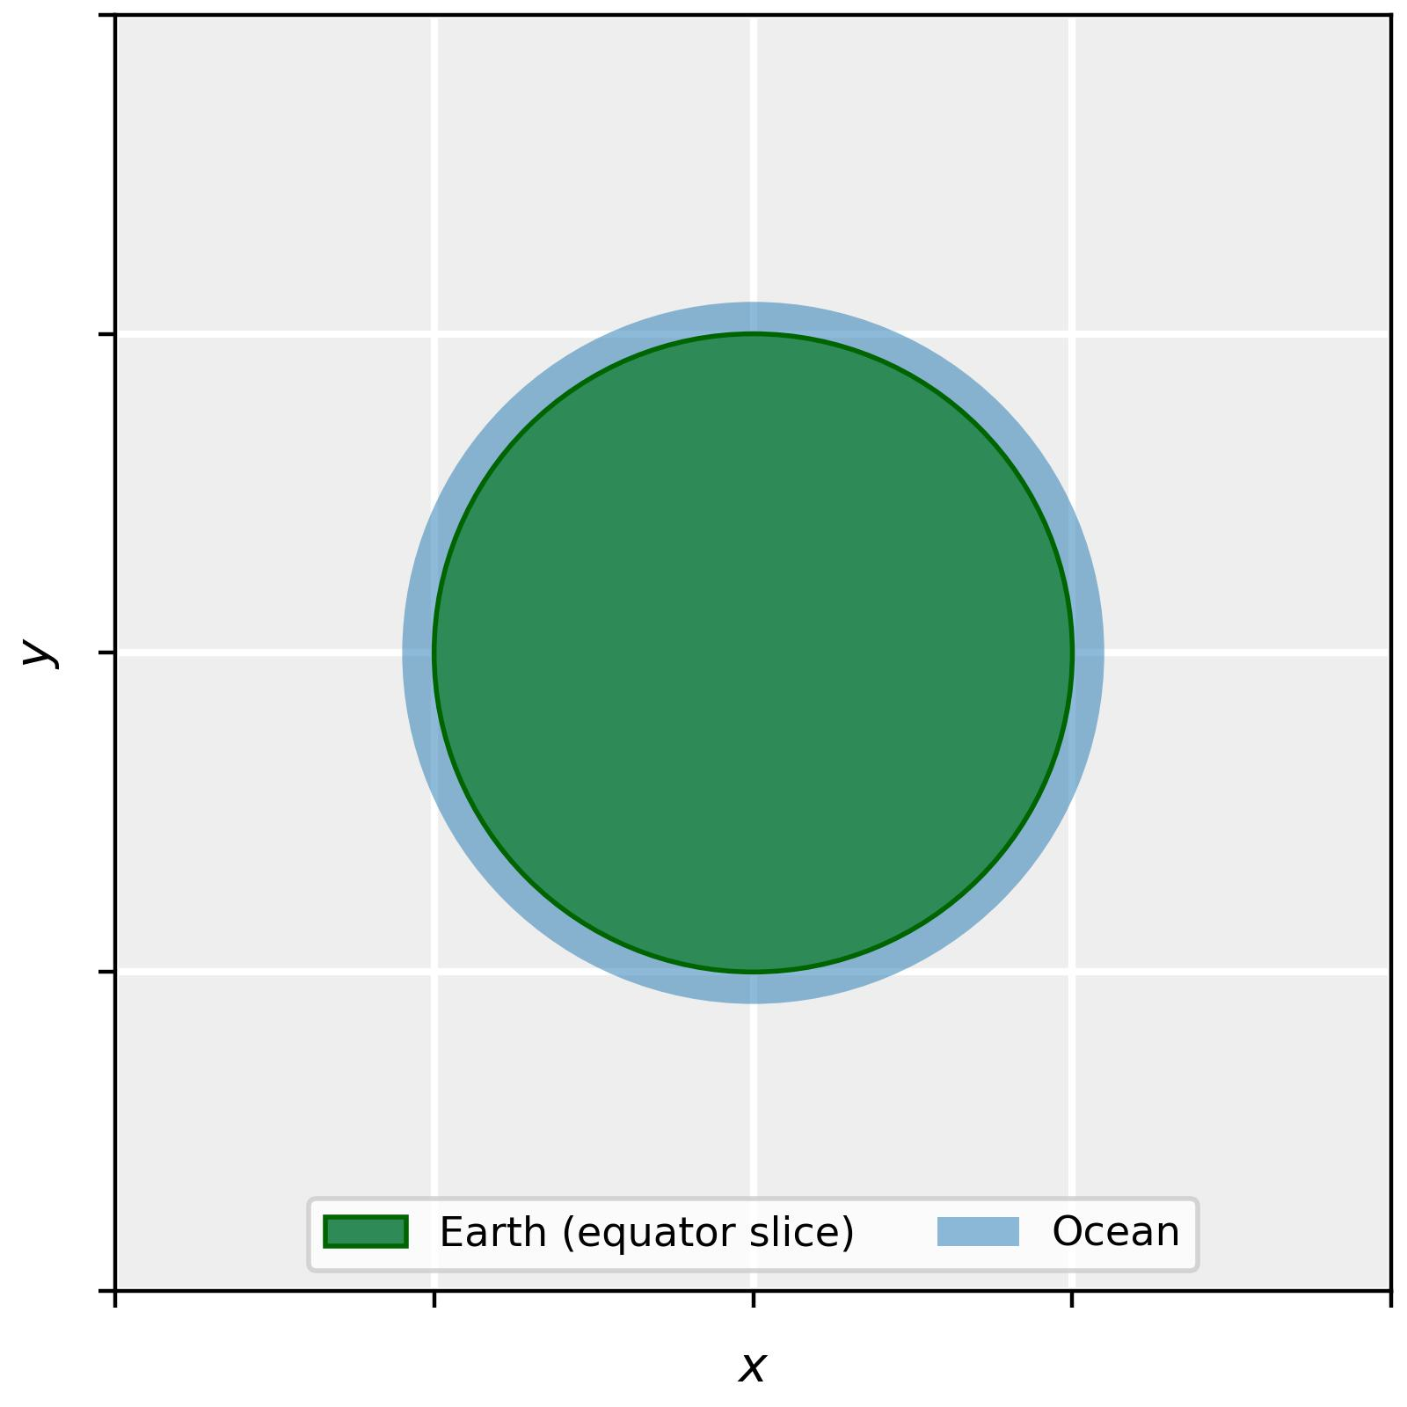

Slide 5
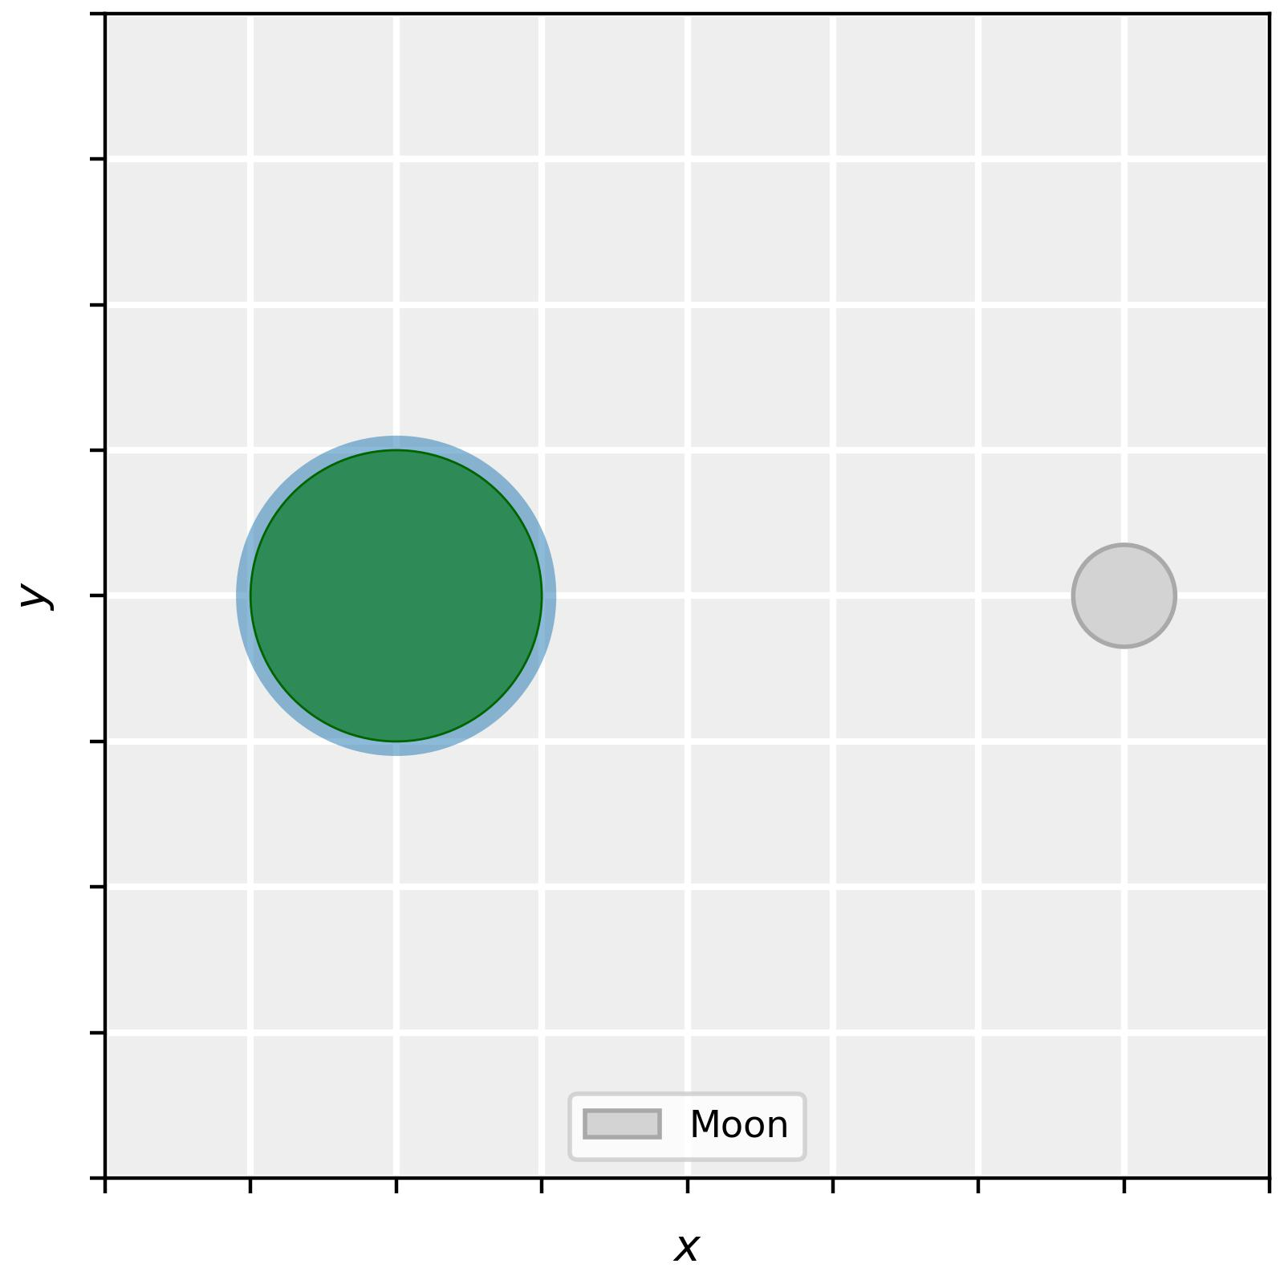

Slide 6


Slide 7
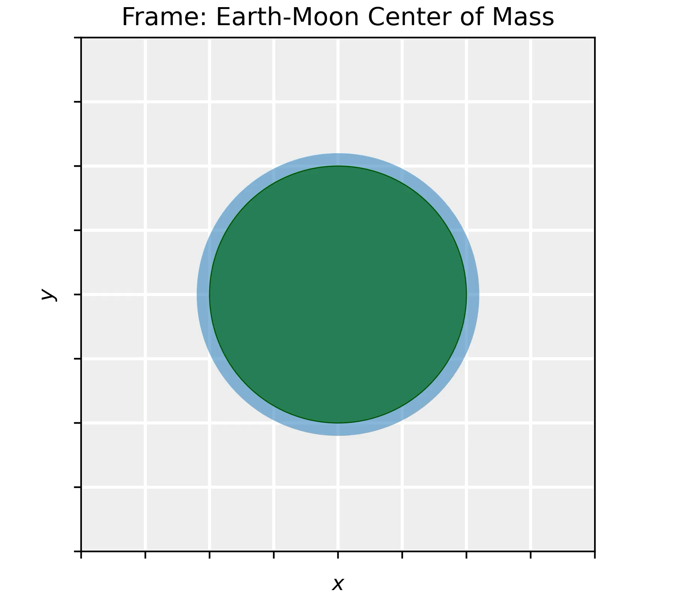

Slide 8
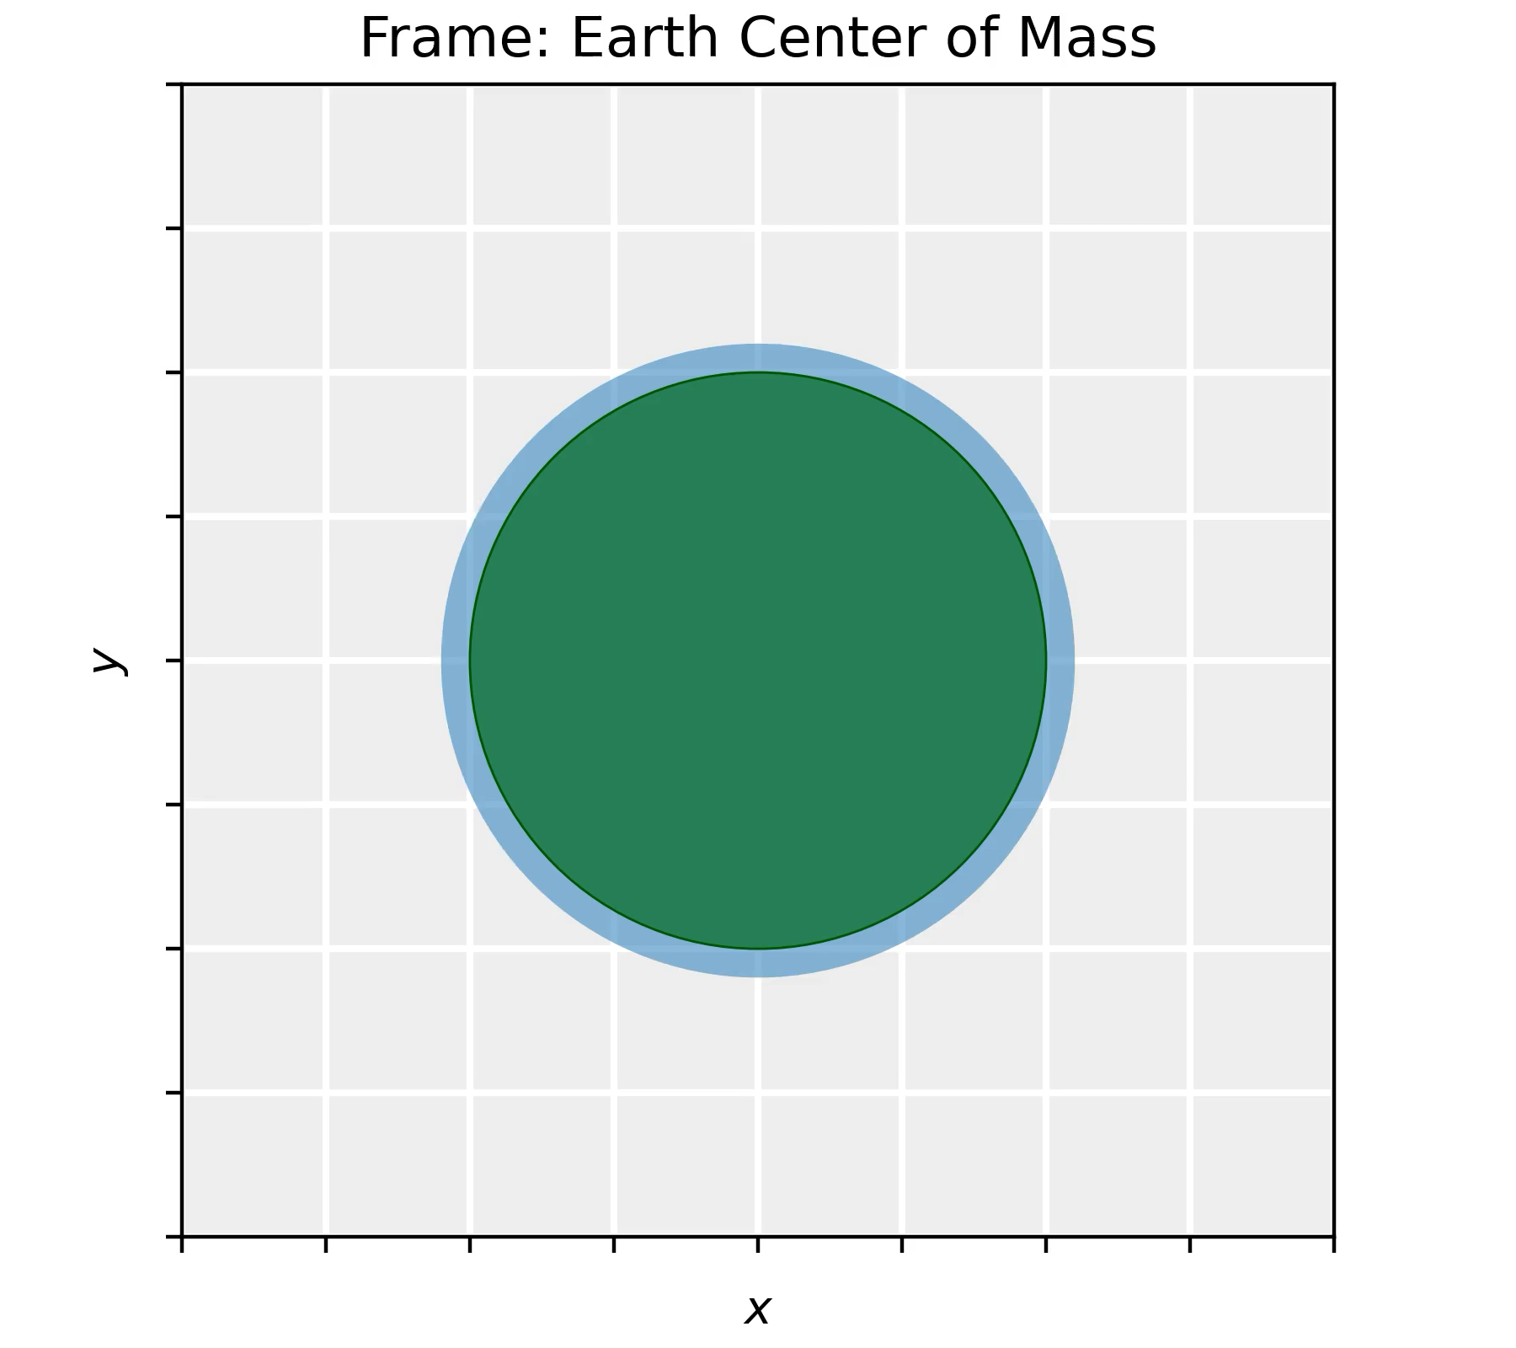

Slide 9
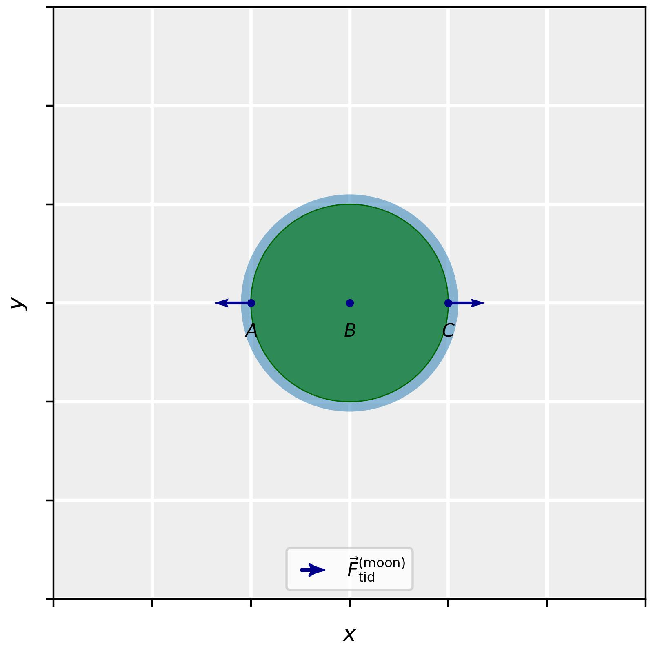

Slide 10


Slide 11
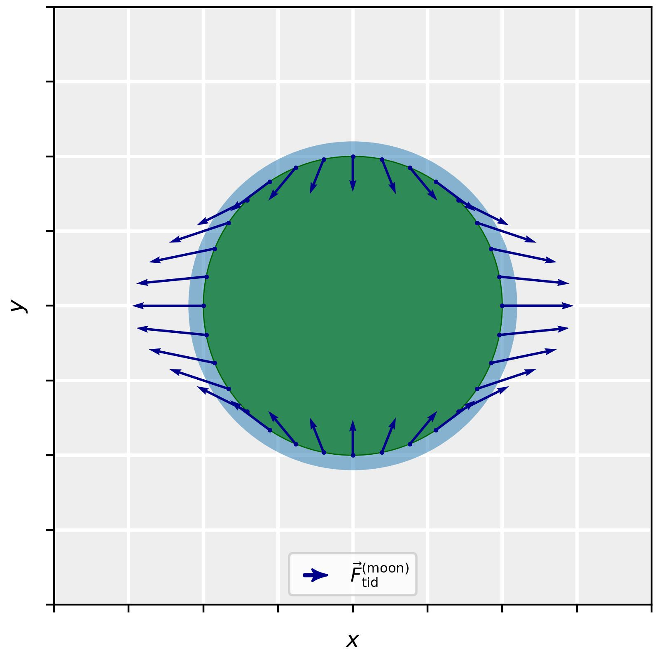

Slide 12
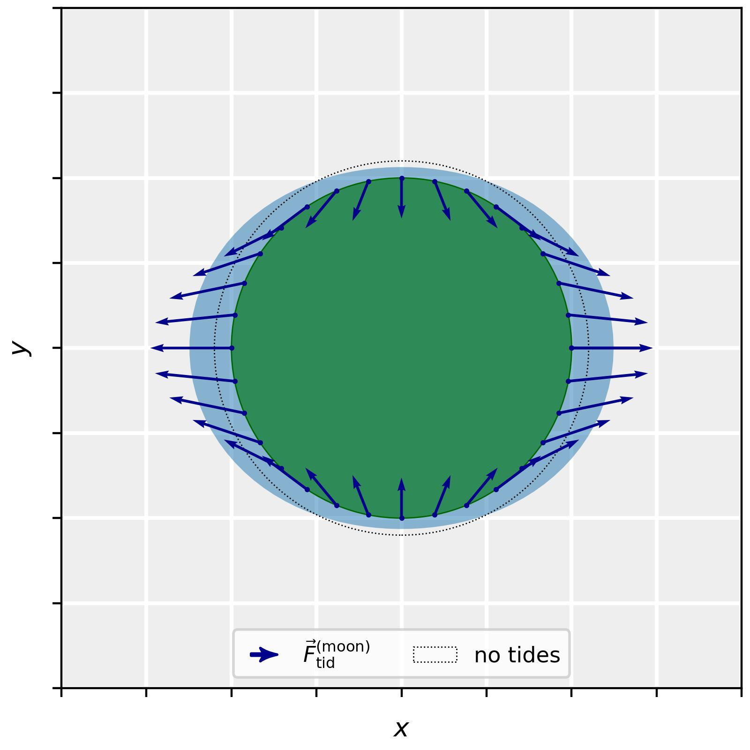

Slide 13
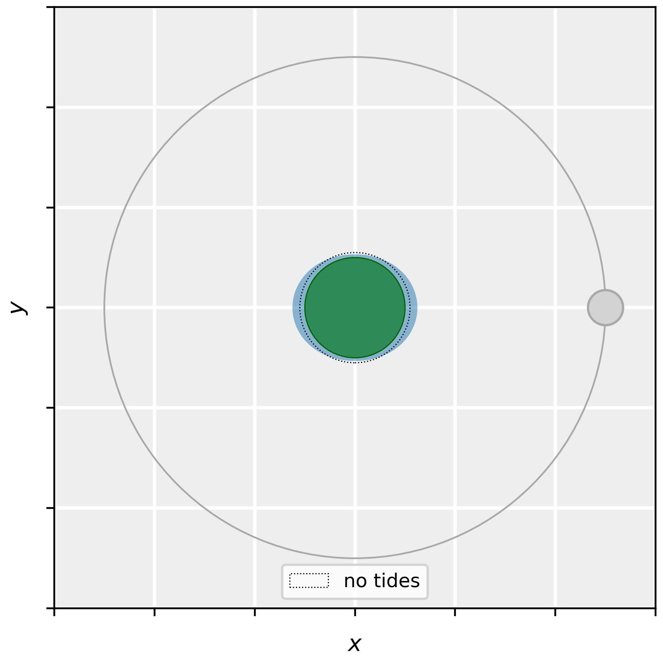

Slide 14
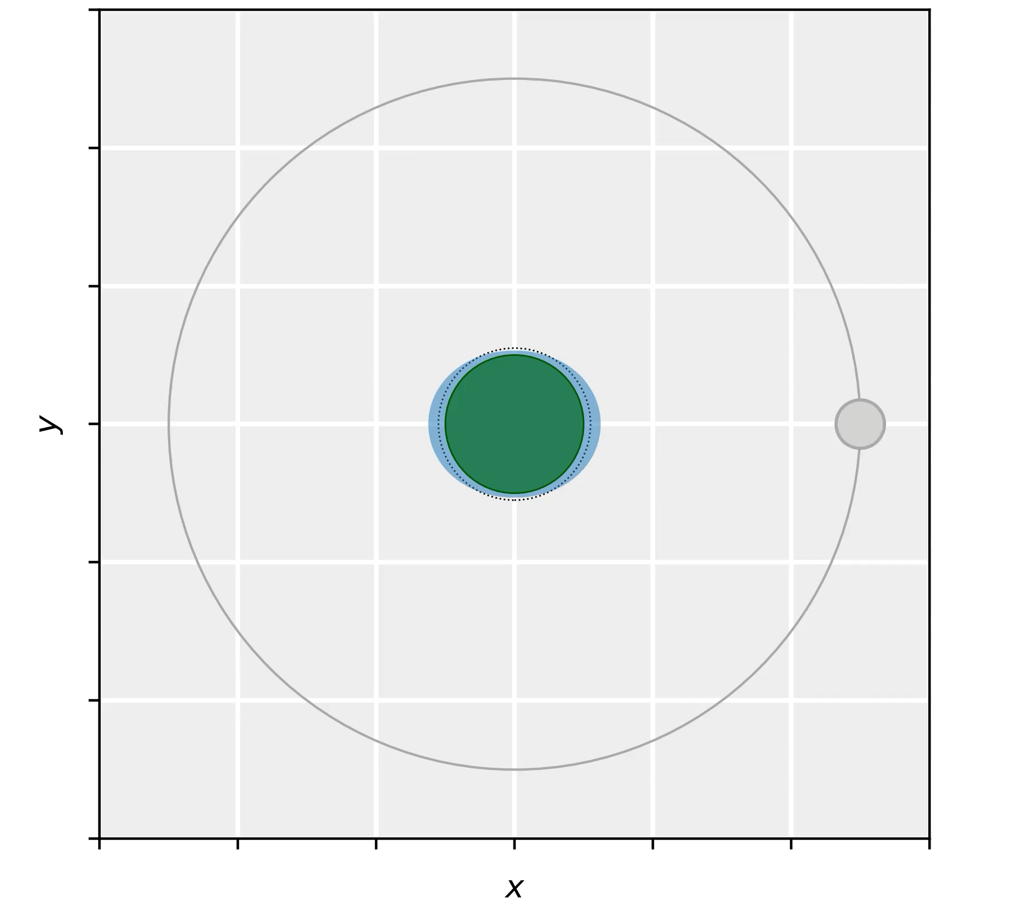

Slide 15
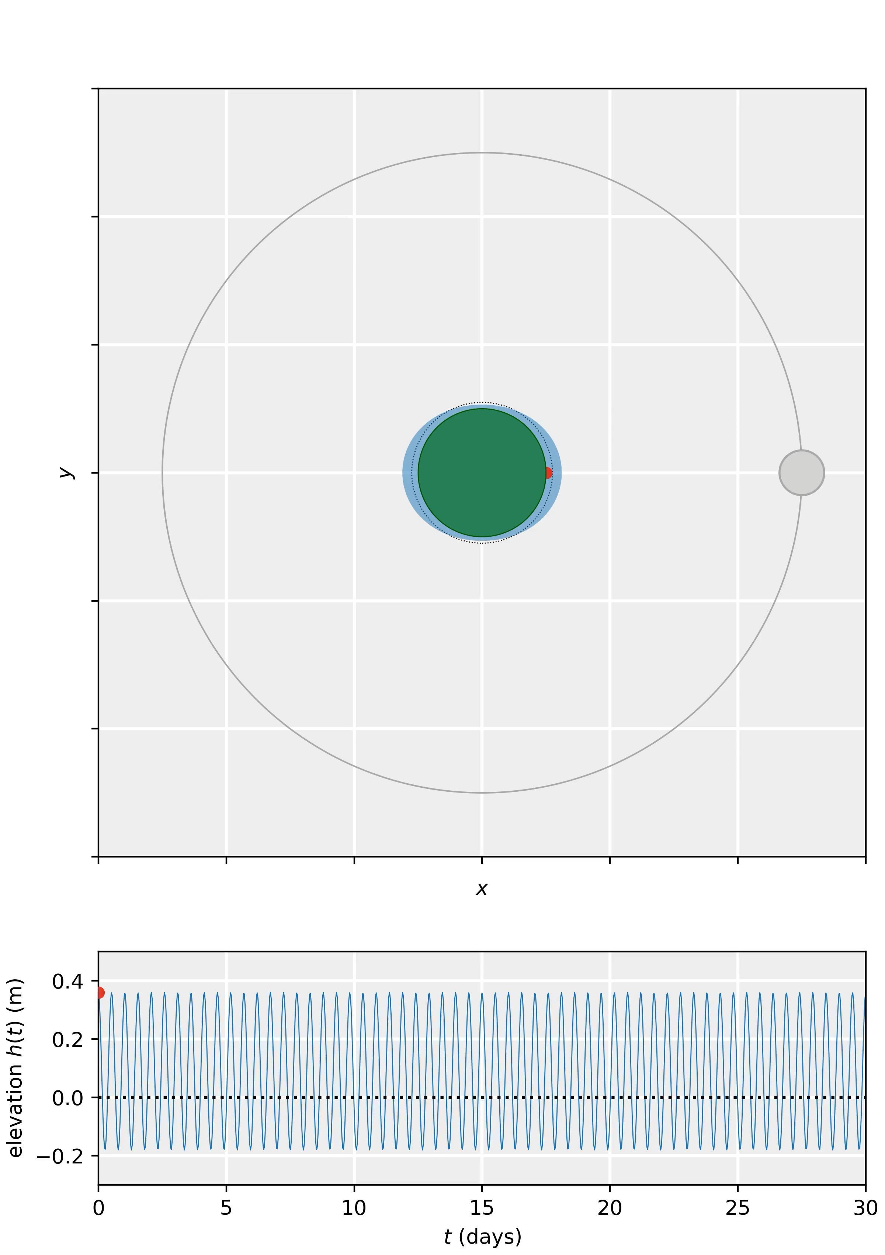

Slide 16
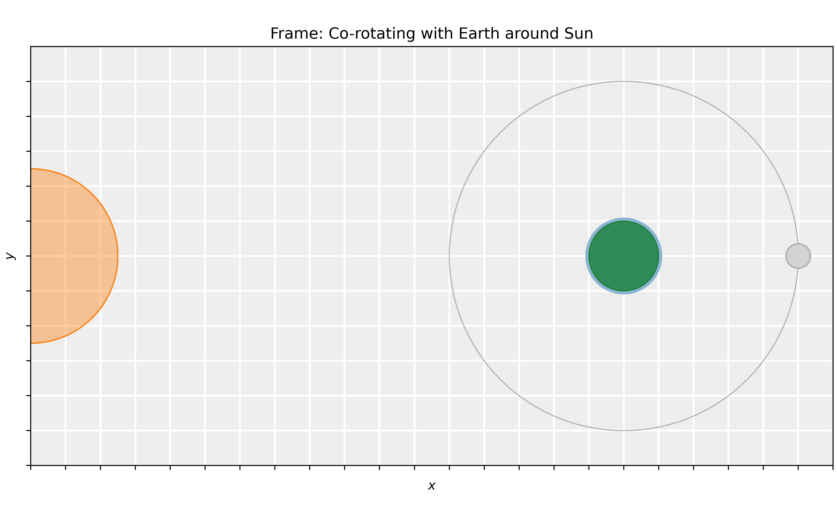

Slide 17


Slide 18


Slide 19
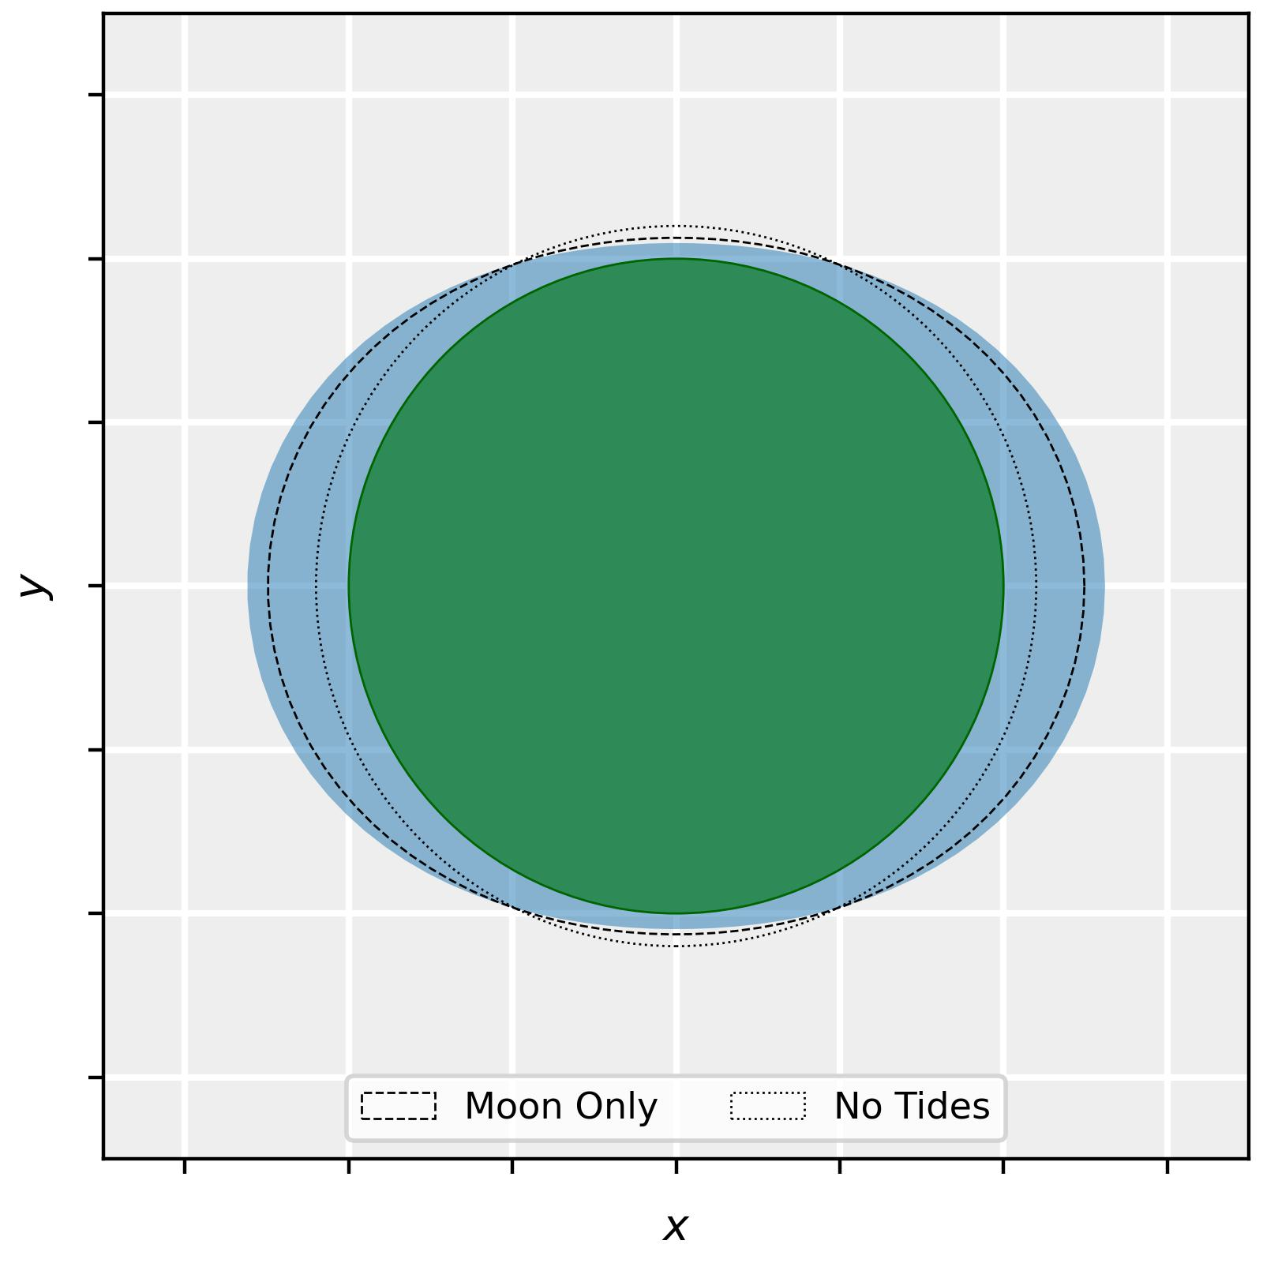

Slide 20
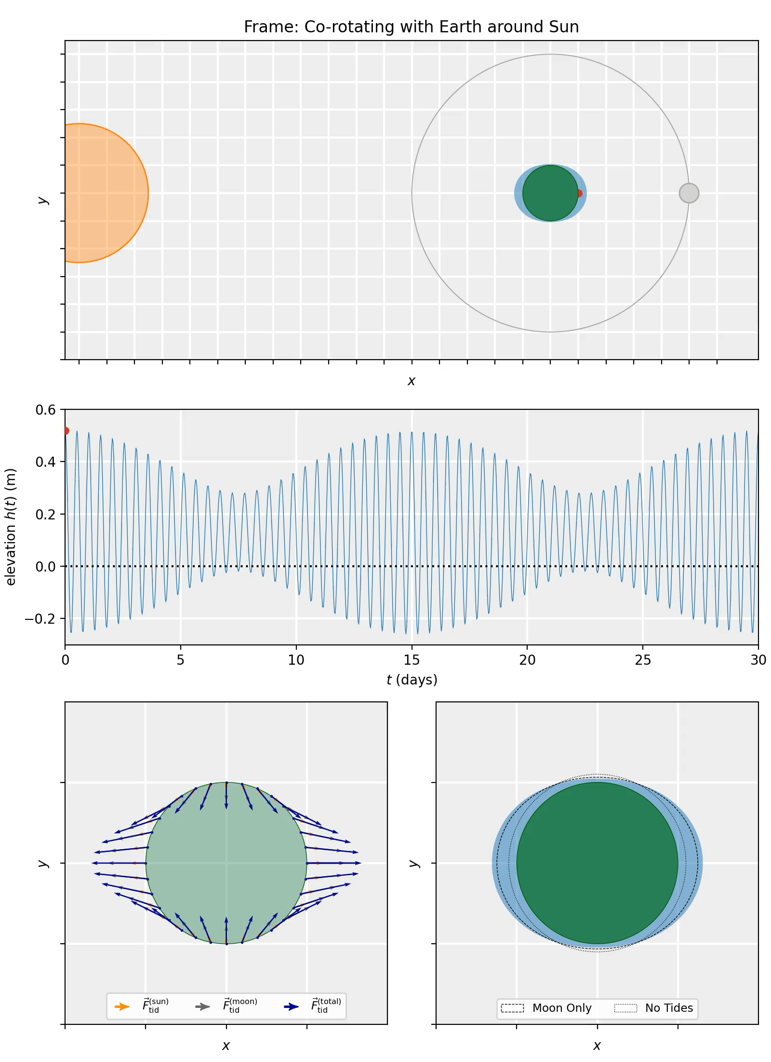
Neap Tide
Spring Tide
Neap Tide

Slide 21
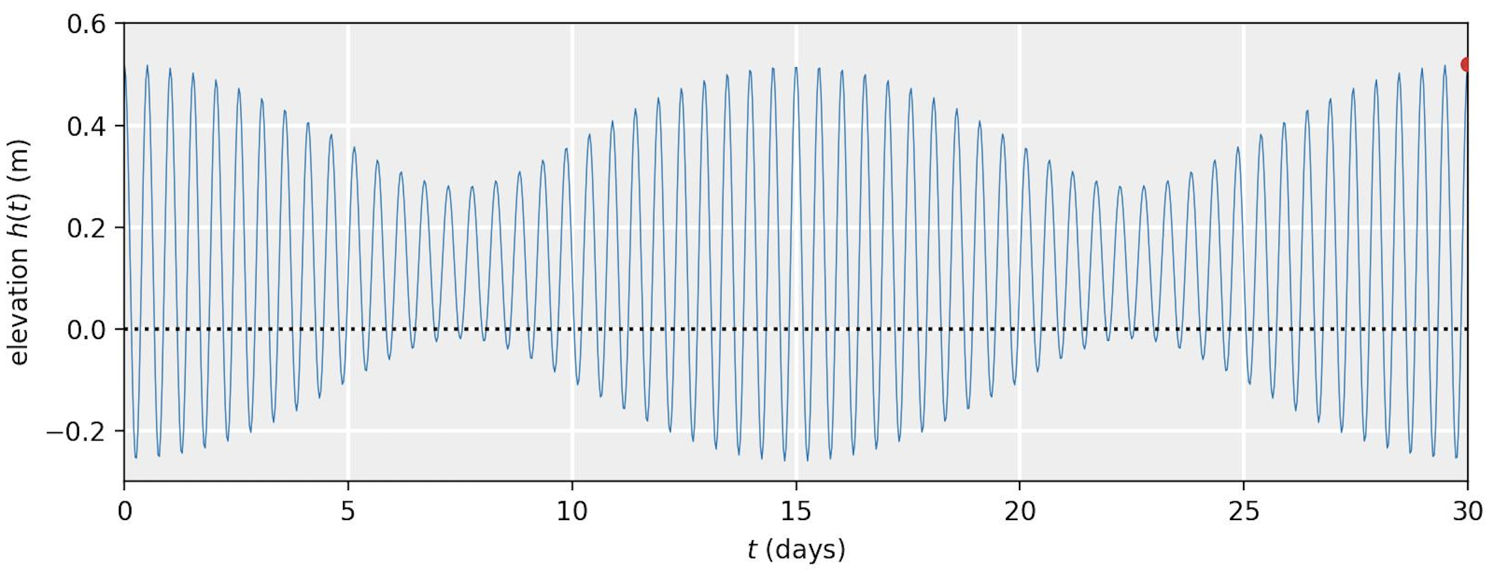
What about Real Tides?

Slide 22
Implementation & Student Experience
Animations are used in lectures (can be extended to lecture clips or tutorials):
Active setting using Predict Explain Observe Explain (PEOE) principle
Student Experience:
“Animations help me develop more physical intuition.”
“Animations help me picture the time evolution of system and the meaning of initial conditions.”
“Animations force me to think about what the solutions should be, instead of blindly calculating stuff right away.”
“Animations show me visually which assumptions and approximations go into the solutions of a problem.”
* e.g.: S Van den Eynde, M Goedhart, J Deprez, M De Cock, International Journal of Science and Mathematics Education 21 (1), 25-47

Slide 23
The Digital Demos Database
The animations that are developed so far can be found in on the physics demos website (Digital Demos tab):
https://physicsdemos.web.rug.nl/digital-demos/
Mathematical details of the tides animations:
https://physicsdemos.web.rug.nl/digital-demos/classical-mechanics-dd/tidal-forces/

Slide 24
Questions?

